Slide 1
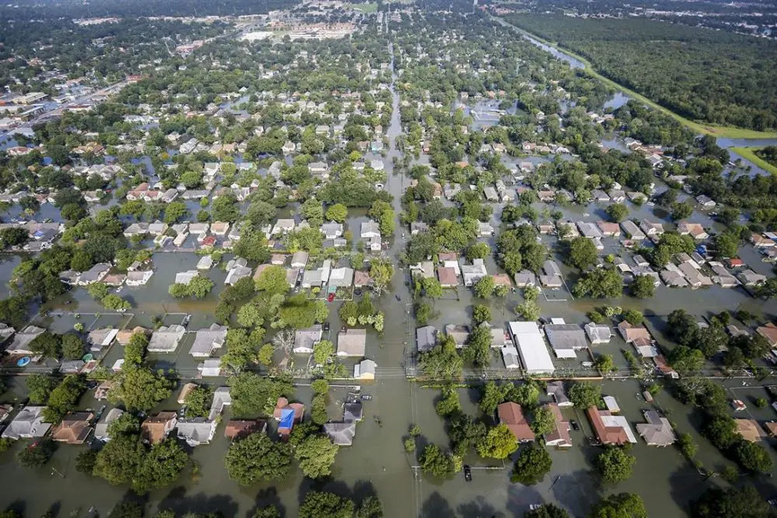
Fort Bend County
Hazard Mitigation Action Plan
2023 Update
Steering Committee Meeting #4
Plan Maintenance & Mitigation Actions
May 30, 2023 | 1:00 pm
If you are joining virtually, please enter your name and department/agency in the chat.
Notes:
Photo credit - https://www.houstonpublicmedia.org/articles/news/2018/03/14/273286/fort-bend-county-reports-harvey-destroyed-or-damaged-6800-homes/

Slide 2
Today’s
Agenda
Welcome
Progress Report
Public and Stakeholder Outreach
Maintaining the 2023 HMP
Identifying Mitigation Strategies
Schedule
Questions/Next Steps/Wrap Up
Notes:
Good morning! Today, we are going to go over the risk assessment results for each of the hazards of concern and then walk you through identifying and developing mitigation actions for your community.

Slide 3
Project Schedule
✓ | November 2022 | Kick-Off Meetings
✓ | November – February | Data Collection and Update Hazard Profiles
✓ | February 9, 2023 | Steering Committee Meeting #2 (Goals and Objectives)
✓ | March 29, 2023 | Risk Assessment Presentation and Identifying Mitigation Actions
❒ | June 7, 2023 | Mitigation actions due (County)
❒ | June 9, 2023 | Draft sections (Volume I) available for Steering Committee Review (OneDrive)
❒ | June 16, 2023 | All input from Steering Committee and Planning Partnership due
❒ | June 19-July 3, 2023 | Public Review Period
❒ | June 19, 2023 | Draft Plan Presentation (virtual)
❒ | July 7, 2023 (tentative) | Submit Plan to TDEM
❒ | August 21, 2023 (tentative) | Submit Plan to FEMA
❒ | October 5, 2023 (tentative) | APA
Notes:
To ensure we get as much input from the municipalities as possible, we revised the schedule a little bit. This week we will be sending out the annexes to the municipalities for their review/input. They will have until June 8th to provide us with any missing information. If we do not have anything from them by the 8th, their annexes will be posted as-is for public review. However, they will have time to make any revisions during the public review period.
The plan will be posted online for 14 days and the public is encouraged to review and comment. We will provide social media tools to use when posting.
We need to schedule our last meeting – draft plan presentation – does June 27th work?

Slide 4
Jurisdiction | Mitigation Actions | Notes
Fort Bend County | NEED ACTIONS | Need to identify mitigation actions for the County and for the LIDs
Arcola (C) | X | No input on actions received to date; Tt developed actions for the city; annex will be sent to city on 5/30/23
Beasley (C) | X | Received actions; Tt developed additional actions to meet the two actions/hazard requirement; annex will be sent to city on 5/30/23
Fairchilds (V) | X | Received actions; Tt developed additional actions to meet the two actions/hazard requirement; annex will be sent to village on 5/30/23
Fulshear (C) | X | Received actions; Tt developed additional actions to meet the two actions/hazard requirement; annex will be sent to city on 5/30/23
Katy (C) | Not Participating
Kendleton (C) | X | Annex will be sent to city on 5/30/23
Meadows Place (C) | X | Received actions; Tt developed additional actions to meet the two actions/hazard requirement; annex will be sent to village on 5/30/23
Missouri City (C) | X | Annex will be sent to city on 5/30/23
Needville (C) | X | Received actions; Tt developed additional actions to meet the two actions/hazard requirement; annex will be sent to village on 5/30/23
Orchard (C) | X | Received actions; Tt developed additional actions to meet the two actions/hazard requirement; annex will be sent to village on 5/30/23
Pearland (C) | Not Participating
Pleak (V) | X | Received actions; Tt developed additional actions to meet the two actions/hazard requirement; annex will be sent to village on 5/30/23
Richmond (C) | X | Received actions; need to identify two actions for disease outbreak/pandemic
Rosenberg (C) | X | Received actions; need to identify two actions for disease outbreak/pandemic
Simonton (C) | X | Received actions; need to identify two actions for disease outbreak/pandemic
Stafford (C) | NEED ACTIONS | No input on actions received to date
Sugar Land (C) | X | Received actions; need to identify two actions for disease outbreak/pandemic
Thompsons (C) | NEED ACTIONS | No input on actions received to date
Weston Lakes (C) | NEED ACTIONS | No input on actions received to date

Slide 5
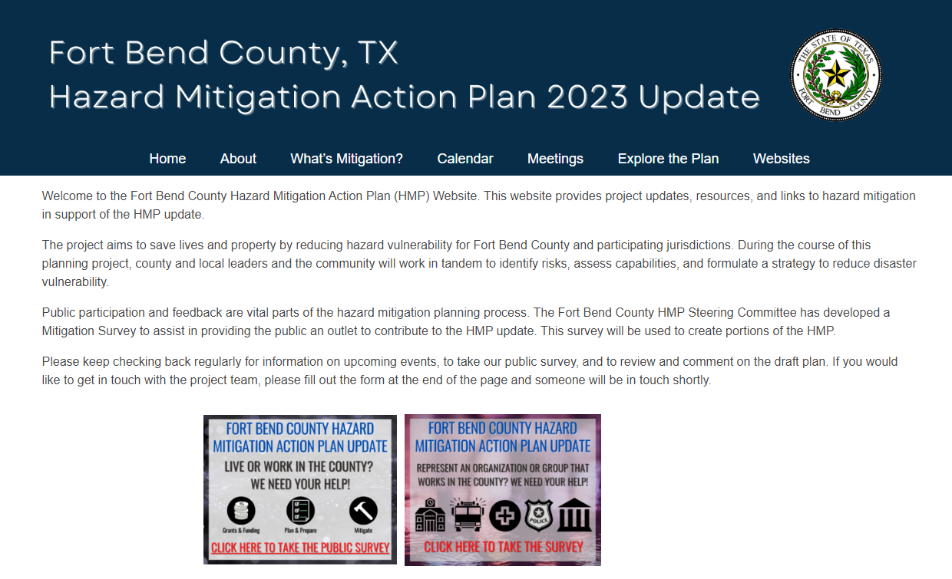
Public and Stakeholder Outreach
Public Outreach Toolkit
Social media templates and posts
Press release templates
Printable materials
Surveys
Stakeholders
Neighboring communities
Public
County HMP website
Thank you to everyone for helping with this!
Notes:
Ongoing – we will be turning off the public input surveys this week. The next survey will be posted during the public review period.

Slide 6
How is Fort Bend County and the participating jurisdictions going to keep the plan current over the next five years?
Plan Maintenance
Notes:
Because the HMP is a living document, we need to show how we will keep the plan current and up-to-date. Section 7 describes how we will do this over the next five years
Plan maintenance is the process the planning team establishes to track the plan’s implementation progress and to inform the plan update. The plan must include a description of the method and schedule for monitoring, evaluating, and updating it within a 5-year cycle.
Today, we need to determine how often the County will meet to monitor, evaluate, update, and implement the 2023 HMP.

Slide 7
Plan Maintenance
2023 HMP
Monitor
Evaluate
Update
Integrate
Public Involvement
HMP Coordinator
Monitoring
Integration of hazard mitigation with existing and future programs
Continuous evaluation and progress reports
FEMA Worksheets and BAToolSM
Updating
Continued public involvement
Plan Maintenance = keeping the HMP accurate, current, and relevant
Notes:
This section details the formal process that will ensure that the HMP remains an active and relevant document and that the Planning Partnership maintains their eligibility for applicable funding sources. The plan maintenance process includes a schedule for monitoring and evaluating the plan annually and producing an updated plan every five years. In addition, this section describes how public participation will be integrated throughout the plan maintenance and implementation process. It explains how the mitigation strategies outlined in this plan update will be incorporated into existing planning mechanisms and programs, such as comprehensive land use planning processes, capital improvement planning, and building code enforcement and implementation.
Annual maintenance and reporting is beneficial to the County and communities. We need to provide a method and schedule for keeping the plan current over the next 5 years:
To help with this, we will be implementing the BATool which is an online program to provide status updates on mitigation actions – progress reporting is now automated!
It keeps the plan dynamic and allows everyone to monitor change
It provides an opportunity for grant coordination – you can look at the mitigation actions and identify funding options to go over after (e.g., BRIC and FMA)
It keeps coordination going – people involved now will be involved throughout the next five years
As part of the plan maintenance, we need to identify the following:
Who is the HMP Coordinator for the County? They will be responsible for submitting the annual report form to submit to the State and FEMA and coordinating the review meetings.
How often will they be meeting each year to discuss the HMP? This can be a formal meeting or a quick conference call. Typically, it’s annually, however, some counties choose to meet quarterly or twice a year.
Integration – We need to include the process in which each participate will integrate the requirements of the HMP into other planning mechanisms.
Integrate means including hazard mitigation principles, vulnerability information and mitigation actions into other existing community planning to leverage activities that have co-benefits, reduce risk and increase resilience
We will provide a framework to integrate the HMP into plans, codes, etc. like emergency operations plans, training/exercise programs, master/comprehensive plans, debris management plans, capital improvement programs, annual budgets, etc. We have resources municipalities can use to help with integration including a safe growth worksheet.
Public involvement – we need to include how each participant will continue public participation over the next 5 years - the County will need to continue involving the public throughout the 5-year cycle of the HMP. This can be done through the HMP website, the County’s website, and the municipal websites. They can provide a copy of the annual report – providing a general overview of the HMP and progress made on the actions

Slide 8
Plan Maintenance Matrix
Task | Approach | Timeline | Lead Responsibility | Support Responsibility
Monitoring | Preparation of status updates and action implementation tracking as part of submission for Annual Progress Report. | October or upon major update to Comprehensive Plan or major disaster | Jurisdictional points of contact identified in Section 8 (Planning Partnership) and Section 9 (Jurisdictional Annexes) | Jurisdictional implementation lead identified in Section 8 (Planning Partnership) and Section 9 (Jurisdictional Annexes)
Integration | In order for integration of mitigation principles action to become an organic part of the ongoing county and municipal activities, the county will incorporate the distribution of the safe growth worksheet for annual review and update by all participating jurisdictions. | October each year with interim email reminders to address integration in county and municipal activities. | HMP Coordinator and jurisdictional points of contact identified in Section 8 (Planning Partnership) and Section 9 (Jurisdictional Annexes) | HMP Coordinator
Evaluation | Review the status of previous actions as submitted by the monitoring task lead and support to assess the effectiveness of the plan; compile and finalize the Annual Progress Report | Finalized progress report completed by October 14th of each year | Steering Committee; Plan Maintenance element | Jurisdictional points of contacts identified in Section 9 (Jurisdictional Annexes)
Update | Reconvene the planning partners, at a minimum, every 5 years to guide a comprehensive update to review and revise the plan. | Every 5 years or upon major update to Comprehensive/Master Plan or major disaster | HMP Coordinator | Jurisdictional points of contacts identified in Section 9 (Jurisdictional Annexes)

Slide 9
2023
2024
2025
2026
2027
Update the 2023 HMP
Month 1
Municipal adoption resolutions
Confirm planning partnership
Month 1
Annual HMP status meeting with FBCHS&EM
Month 1
Annual HMP status meeting with FBCHS&EM
Month 1
Annual HMP status meeting with FBCHS&EM
Month 2-12
Review the status of previous actions; update status via the BATool℠
Month 2-12
Review the status of previous actions; update status via the BATool℠
Month 2-12
Review the status of previous actions; update status via the BATool℠
Month 2-12
Review the status of previous actions; update status via the BATool℠
Month 11
Prepare status updates and action implementation tracking as part of the annual progress report submittal
Month 11
Prepare status updates and action implementation tracking as part of the annual progress report submittal
Month 11
Prepare status updates and action implementation tracking as part of the annual progress report submittal
Month 11
Prepare status updates and action implementation tracking as part of the annual progress report submittal
Month 12
Generate and distribute annual progress report
Month 12
Generate and distribute annual progress report
Apply for funding for next plan update
Month 12
Generate and distribute annual progress report
Month 12
Generate and distribute annual progress report
Utilize BATool to complete this step
Notes:
This is just a general outline for plan maintenance. Month 1 in 2023 starts when FEMA approves the plan.
We will be using the BATool to send out reminders each year (or however frequently you choose) to remind you to log in and provide an update on your mitigation actions. Emails typically go out 60 days, 30 days, 15 days, 7 days, and 1 day prior to the review cycle (which will be the date the HMP receives APA)
Right now, we are including the BATool for the first year with our contract to update the HMP. The County can choose to extend the BATool service for the life cycle of the 2023 plan. This will make the next update a little easier because the status of mitigation actions will already by done!

Slide 10
BAToolSM
What is it?
Online progress reporting for individual mitigation actions – pre-populated by Tetra Tech
Web-based, SQL server database created by Tetra Tech
Scalable for multiple applications: Federal, State or Local
Secure environment
Includes reporting function
Each jurisdiction has a designated Point of Contact will log in with the general user name and password for the BATool [link: https://www.ttbatool.org ]
Once the plan is approved, we will send around the user name and password
Each jurisdiction will sign in and indicate progress made on mitigation actions
You can add or remove actions as well
Notes:
Why are we using it?
Manages Projects Across your HMP
Automated Reminders
Automated email reminders are sent to motivate staff to review progress, identify obstacles, and complete projects.
Frequent Reviews Leads to Implementation
Reviewing project status is quick and easy. Frequent reviews leads to increased conversations about mitigation and resilience and ultimately increased project implementation.
Helps Position for Funding
Projects can be queried (e.g., key word, hazard, project type) to identify projects that align with new notices of funding opportunities.
Scheduled Reporting
Reports are scheduled and emailed to the points of contact to assist with required maintenance reporting (i.e., mitigation and CRS).

Slide 11
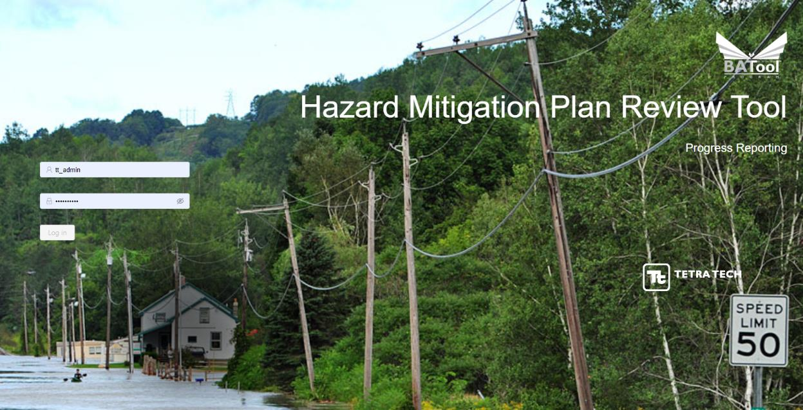
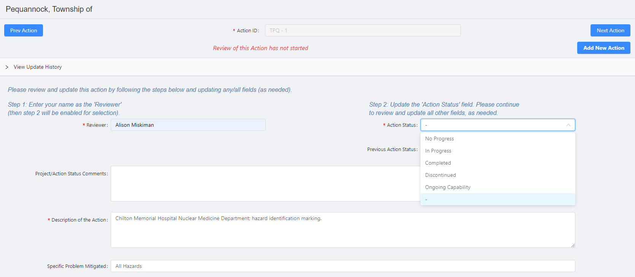
BAToolSM
Fort Bend County
Notes:
Provides an easy interface to add or delete or modify projects
It tracks progress and implementation
And importantly supports increase in grant funding of projects by accessibility to the range of projects on a municipal and county level.
It will also help with CRS annual reporting for those communities that are in the CRS program

Slide 12
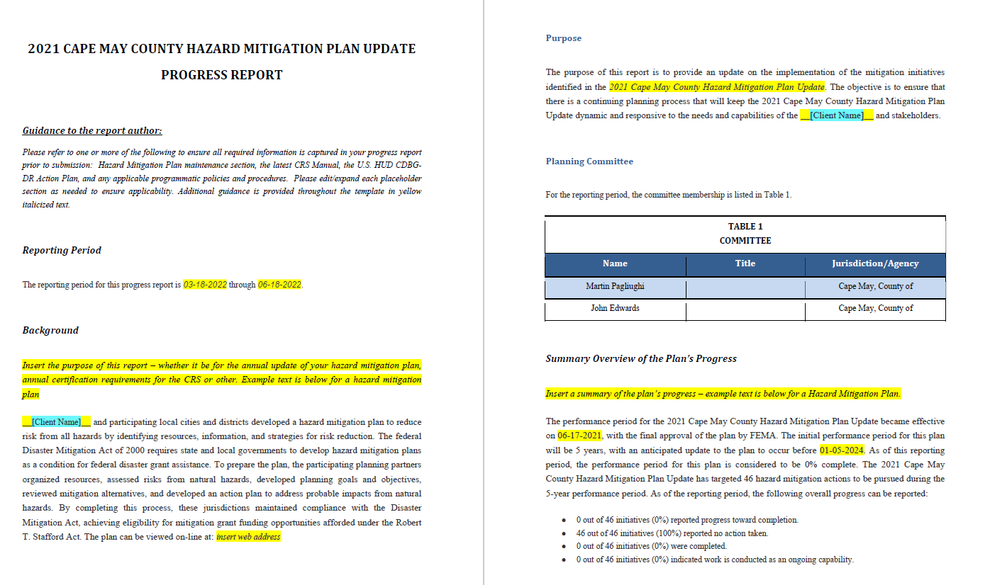
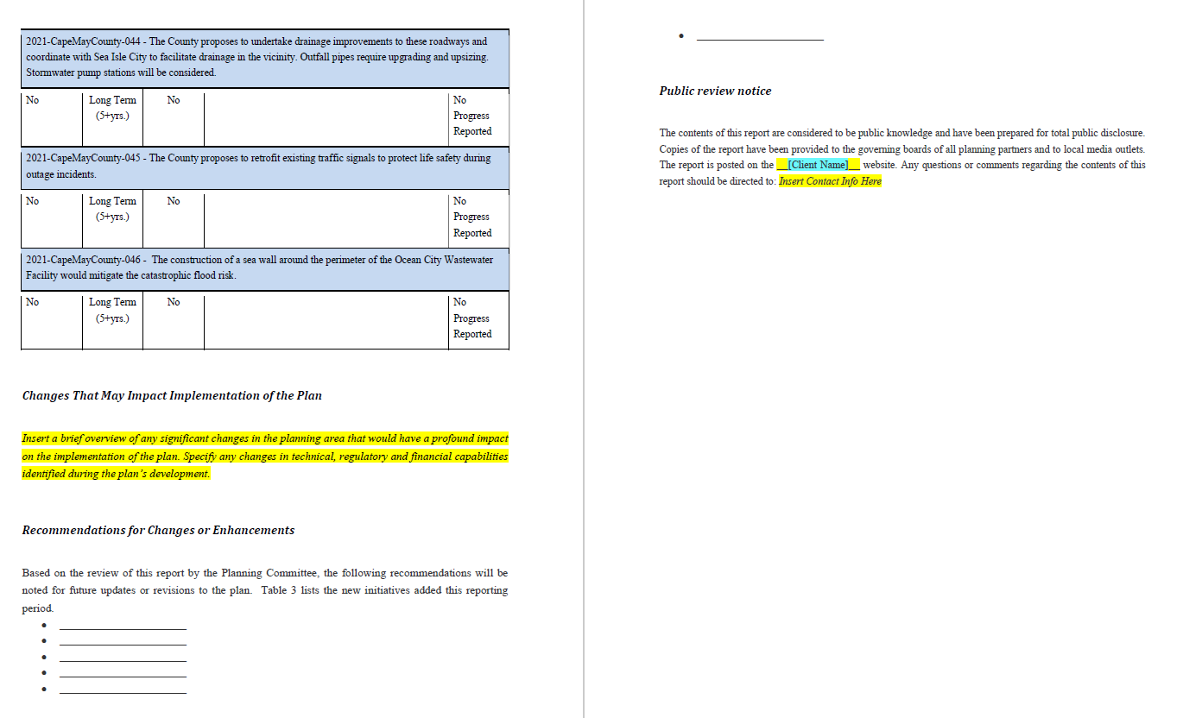

Slide 13
Mitigation Strategy
Notes:
Today, we are going over the mitigation strategy portion of the plan and how to develop mitigation actions for your community.
FEMA refers to the mitigation strategy as the heart of the mitigation plan – the strategy serves as the long-term blueprint for reducing the potential losses identified in the risk assessment.
The strategy describes how you will accomplish the overall purpose of the mitigation plan – you want to tie in the goals/objectives of the plan with your identified strategies/projects

Slide 14
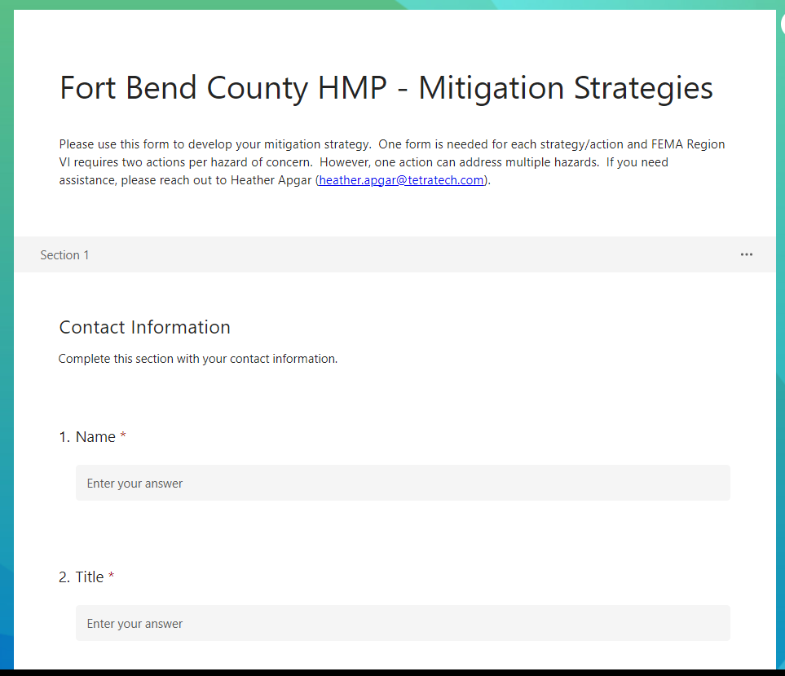
Mitigation Strategy
Complete one form per action – https://forms.office.com/r/skApygNAJZ
Need two actions per hazard of concern
Notes:
https://forms.office.com/r/skApygNAJZ

Slide 15
Mitigation Actions to Consider
Action Starting Point | Dam/Levee Failure | Drought | Extreme Temperature | Flood | Geologic Hazards | Hurricane/ Tropical Storm | Pandemic/ Disease Outbreak | Severe Weather | Tornado | Wildfire | Winter Weather
Countywide Debris Management Plan | X |  |  | X | X | X |  | X | X | X | X
Substantial Damage Management Plan | X |  |  | X | X | X |  | X | X | X | X
Identification of key healthcare stakeholders and providers (including medical clinics and drugstores) |  |  | X |  |  |  | X
Inventory of healthcare facilities (hospitals, medical clinics, long-term care facilities) |  |  | X |  |  |  | X
Dam Safety Evacuation Education and Outreach | X |  |  | X
High Water Warning Systems | X |  |  | X |  | X |  | X
Develop and implement an education and outreach program to architects, builders and developers who work in the County to understand the hazard risks in the County | X |  |  | X | X | X |  | X | X | X | X
Critical facilities in the floodplain (e.g., MUD stations, WWTP) |  |  |  | X |  | X |  | X
Dams – Barker Reservoir, Lake Sommerville, Kitty Hollow | X |  |  | X

Slide 16
Questions?

Slide 17
Fort Bend County Project Contacts
Greg Babst, Deputy Emergency Management Coordinator (281) 238-3428 | Gregory.Babst@fortbendcountytx.gov
Tetra Tech Project Contacts
Brian Rutherford, Project Manager (281) 414-6741 | brian.rutherford@tetratech.com | Heather Apgar, Lead Planner (973) 630-8046 | heather.apgar@tetratech.com
Thank You!

